Slide 1
CUSTOMER SEGMENTATION
Simplon.co
Notes:
Kamel

Slide 2
THE DATA
01
02
03
SHAPE
PEOPLE
PRODUCTS
ROWS : 2240
Columns : 29
Customers identified per ID,, Year, Education etc…
Amount spent on different products
04
05
06
PROMOTION
PLACE
OVERVIEW
The offers accepted per customers
Number of purchases per place
Somme missing values and errors in Marrital_Status
Notes:
Kamel

Slide 3
Our GOAL : The perfect Knowledge of your customers
Profile
Occupation
Age:
41 years old
Education :
Graduate Degree
Status:
Not Single
Income Range:
$33,000
Kids at Home:
1 kid
Education
Products
Graduation (47%)
Meat
PhD (19%)
Wine
Master (17%)
Fish
Basic (7%)
Gold
2nd Cycle (10%)
Notes:
Indi
We believe that in the current highly competitive retail world, customers must have the best possible experience to be satisfied and become loyal. We help companies to become the best at acknowledging their customers needs.
This is our proposition if you want to become the best.

Slide 4
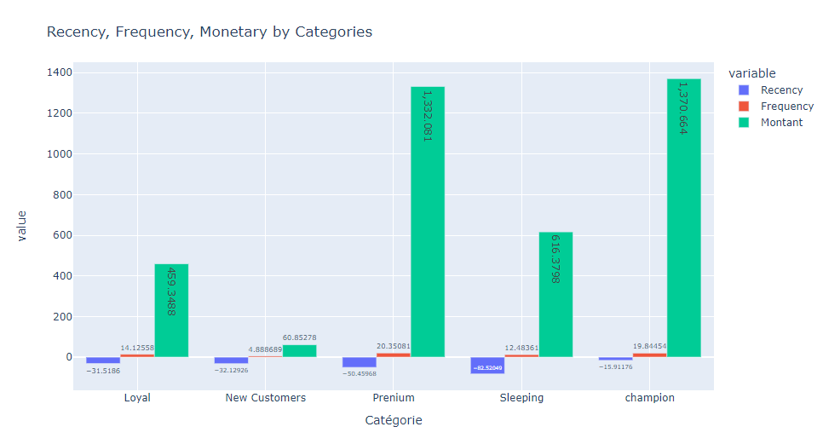
Notes:
Ahmed

Slide 5
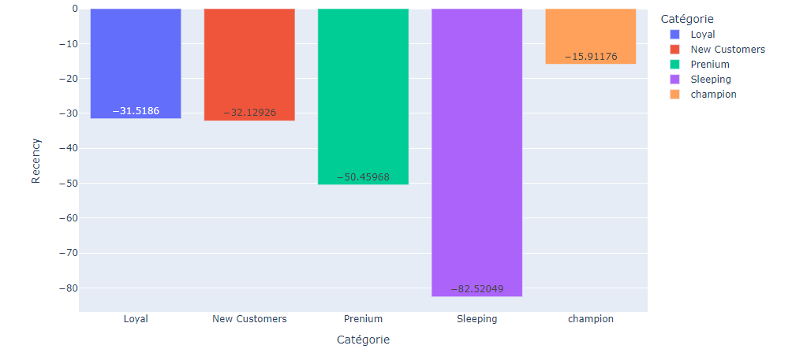
Notes:
Ahmed

Slide 6




THE Champions TYPE
Profile
Age : 45 years Old
Income : $74,000
Specificity
Monetary
Frequency
Recency
Notes:
Ahmed

Slide 7
Premium
Âge
47 years old
Income
73 K
R
F
M
Notes:
Ahmed

Slide 8
The SLEEPING TYPE
Specificity
Age
44 years old
Income
$52,000
Monetary
Frequency
Personality
Recency
Not really the type we should be targeting for the next campaigns
Notes:
Ahmed

Slide 9
THE LOYAL TYPE
Profile
Occupation
Age:
46 years old
Education :
Graduate Degree
Status:
Not Single
Income Range:
$53,000
Kids at Home:
2 kids
Education
Products
Graduation (52%)
Meat
PhD (23%)
Wine
Master (19%)
Fish
2nd Cycle (8%)
Gold
Basic (0%)
Notes:
Indira

Slide 10
The perfect New Customer
Profile
Occupation
Age:
41 years old
Education :
Graduate Degree
Status:
Not Single
Income Range:
$33,000
Kids at Home:
1 kid
Education
Products
Graduation (47%)
Meat
PhD (19%)
Wine
Master (17%)
Fish
Basic (7%)
Gold
2nd Cycle (10%)
Notes:
Indi
We believe that in the current highly competitive retail world, customers must have the best possible experience to be satisfied and become loyal. We help companies to become the best at acknowledging their customers needs.
This is our proposition if you want to become the best.

Slide 11

The Strategy

Slide 12
MERCI

Slide 13
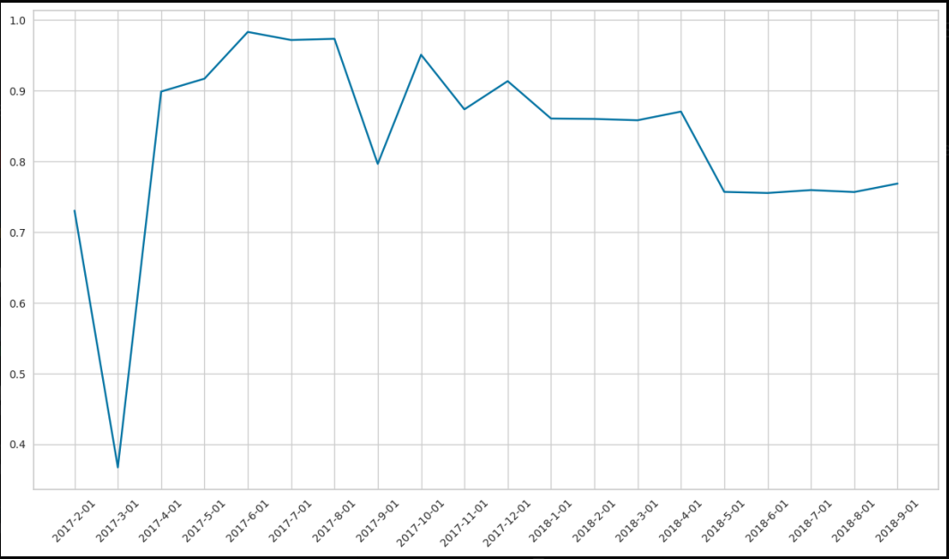
CONTRAT DE MAINTENANCE

Slide 14
MERCI

